Slide 1
Ontology Building in Action
Hasan TÜRKSOY
Compiled, partly based on various online tutorials and presentations, with respect to their authors

Slide 2
RDF/OWL in Protégé
Example
Notes:
[6]

Slide 3
How to build an ontology?
Steps:
determine domain and scope
enumerate important terms (concepts)
organize the terms (concepts/classes)
define properties
paraphrase and formalise the definitions
Notes:
[3, 5]

Slide 4
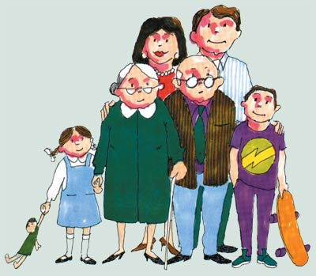
Step 1: Determine Domain and Scope
Domain: family relations
Application: see some family members’ relations
Possible questions:
Is this person has a sibling?
Give the nieces/nephews of this person (if exist)?
Is this person the parent of that one?
Is this person and that one are relative to each other?
Notes:
[3] -> kendi örneğini geliştir

Slide 5

Step 2: Enumerate Important Terms
Mother
Daughter
Man
Woman
Person
Nephew
Aunt
Male
Uncle
Father
Niece
Sibling
Female
Son
Children
Brother
Sister
Notes:
[3] -> kendi örneğini geliştir...

Slide 6
Step 3: Organize the Terms
Gender
Male
Female
Person
Child
Son
Daughter
Sibling
Sister
Brother
Uncle
Aunt
Nephew
Niece
Parent
Father
Mother
name.String
hasChild.Person
hasDaughter
hasSon
hasGender.Gender
hasParent.Person
hasFather
hasMother
hasSibling.Person
hasBrother
hasSister
hasNephew.Person
hasNiece.Person
hasUncle.Person
hasAunt.Person

Slide 7
Step 4: Paraphrase and formalise the definitions
Gender = {Male,Female}
Person = Man OR Woman
Man = Person AND Male
Woman = Person AND Female
Aunt = Woman AND (hasNephew OR hasNiece)
Nephew = Man AND (hasUncle OR hasAunt)
Niece = Woman AND (hasUncle OR hasAunt)
Parent = Person AND hasChild.min1
Father = Man AND Parent
Mother = Woman AND Parent
Child = Person AND hasParent.min1
Daughter = Child AND Woman
Son = Child AND Man
Sibling = Person AND hasSibling.min1
Brother = Man AND Sibling
Sister = Woman AND Sibling
Relative = Sibling OR Parent OR Child OR Aunt OR Nephew OR Niece OR Uncle
...

Slide 8
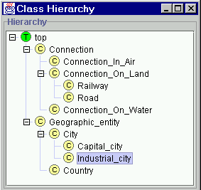
Step 3: Define Classes and Class Hierarchy
Notes:
[3] -> kendi örneğini geliştir

Slide 9
Step 4: Define Slots of Classes
Geographic_entity
End_point
Connection
Country
City
Start_point
Has_capital
Borders_with
Capital_of
Capital_city
Step 5: Define slot constraints
Slot-cardinality
Ex: Borders_with multiple, Start_point single
Slot-value type
Ex: Borders_with- Country
Notes:
[3] -> kendi örneğini geliştir

Slide 10
OWL Example in Protégé (1)
Class
Person superclass
Man, Woman subclasses
Enumerated Classes
Properties
isWifeOf, isHusbandOf
Property characteristics, restrictions
inverseOf
domain
range
Cardinality
allValuesFrom, someValuesFrom, hasValue, minCardinality, maxCardinality, cardinality
Class expressions
disjointWith, unionOf (or), intersectionOf (and), complementOf (not)
Notes:
[3] -> kendi örneğini geliştir
[6]’da detaylar var...

Slide 11
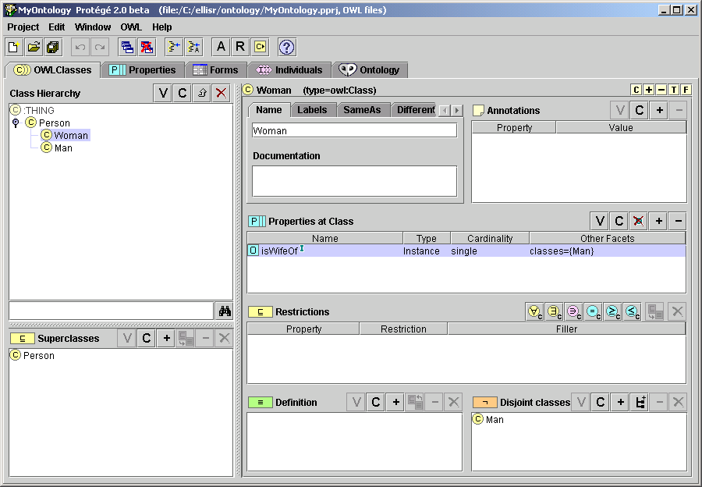
OWL Example in Protégé (2)
Notes:
[3] -> kendi örneğini geliştir

Slide 12
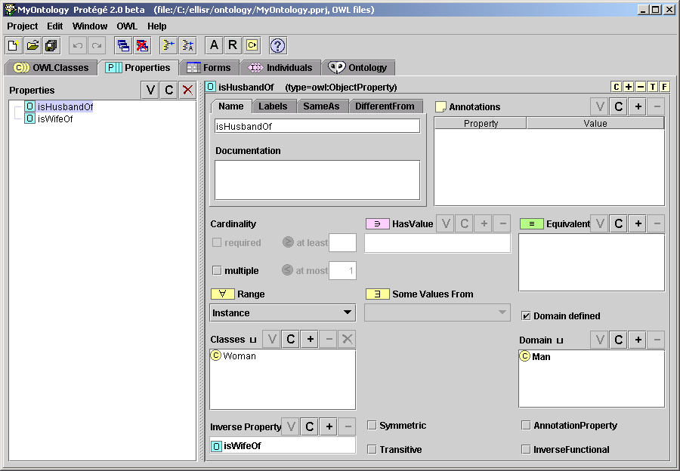
OWL Example in Protégé (3)
Notes:
[3] -> kendi örneğini geliştir

Slide 13
Ontologies vs. Models Acknowledgements: Colin Atkinson
Ontologies
originated from the artificial intelligence world for the purpose of precisely structuring “knowledge”
new “knowledge” derived by automated reasoning
characterized by OWL as the flagship language
formal semantics (description logic)
Models (à la MDA)
originated from the software engineering world for structuring the specification of software, abstracting from platform specific aspects
information defined prescriptively for construction
characterized by UML as the flagship language
semi-formal semantics (metamodels)
Ontologies
?
Models
Notes:
[3]

Slide 14
kaynak\Ian Horrocks - CS646\7.2Lect-2-Ontology-building-2007.ppt

Slide 15
Mola...
Next: Reasoning...

